Slide 1
Rotation in Murre lab
Building Riboprofiling Pipeline
Pin-Chung (Tony) Cheng

Slide 2
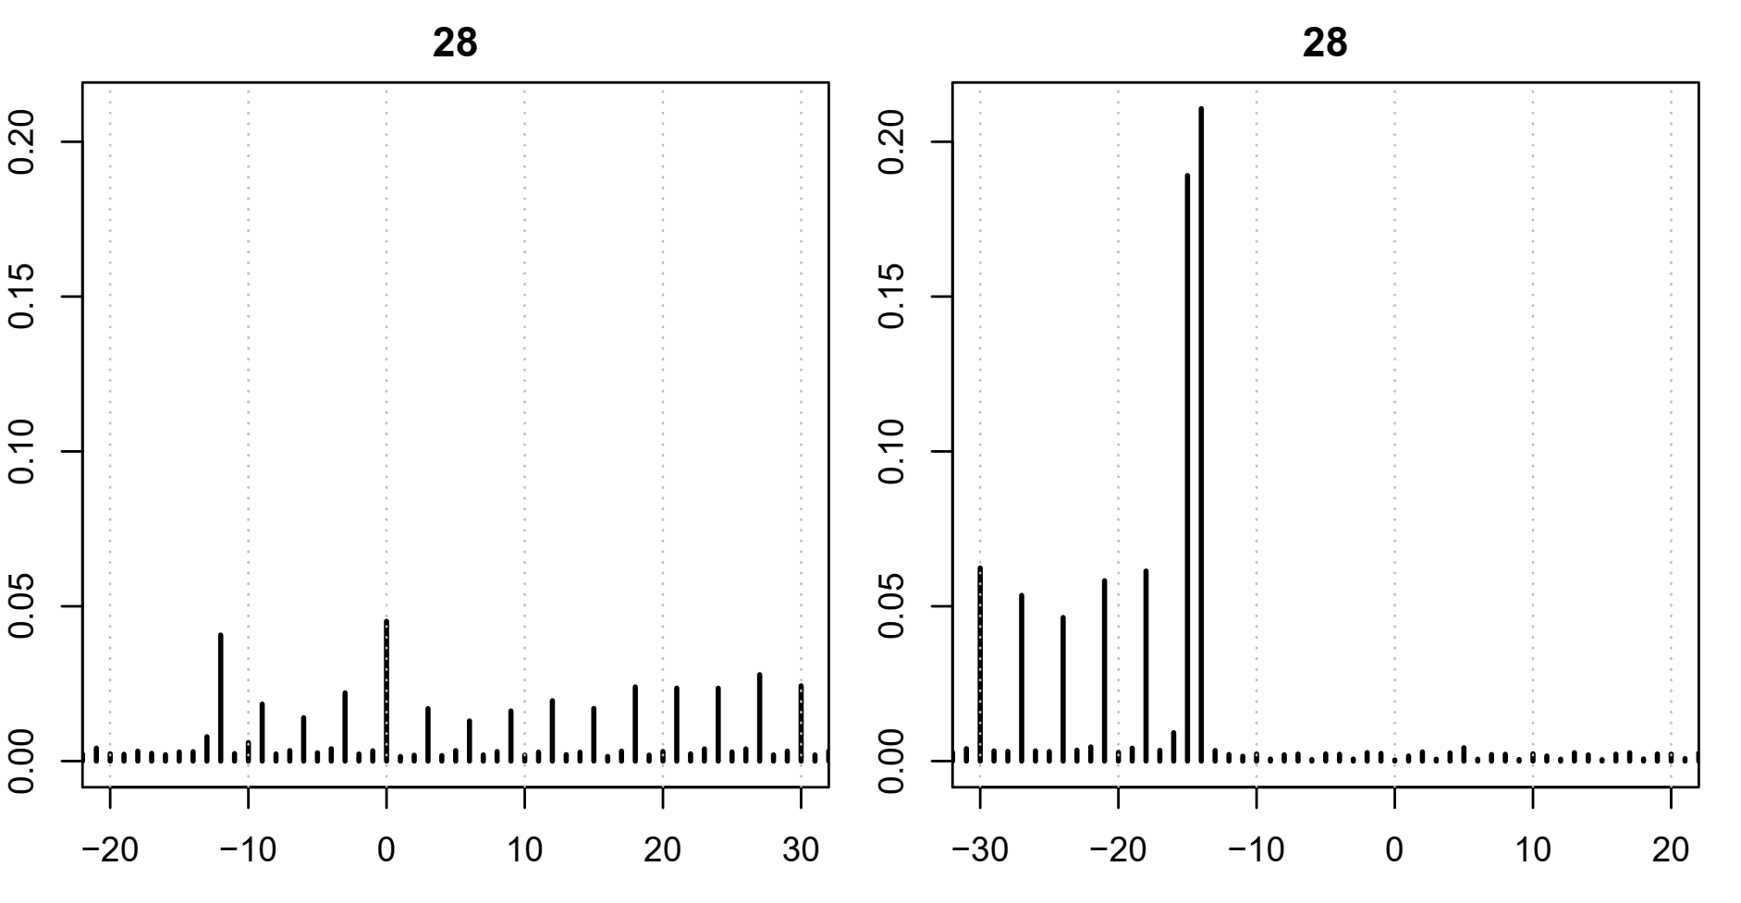
Workflow
Arthur’s Pipeline
-Demultiplex
-Read alignment
-Filter rRNA reads
-Filter read length
…
...
offsetCorrect.sam -> filtered reads files
repre*.gtf -> predicted ORF file
Ribosome
X X X X
X X X X
X X X X
ORF1
CDS1
CDS2
CDS3
Notes:
P-site have 3nt periodicity

Slide 3
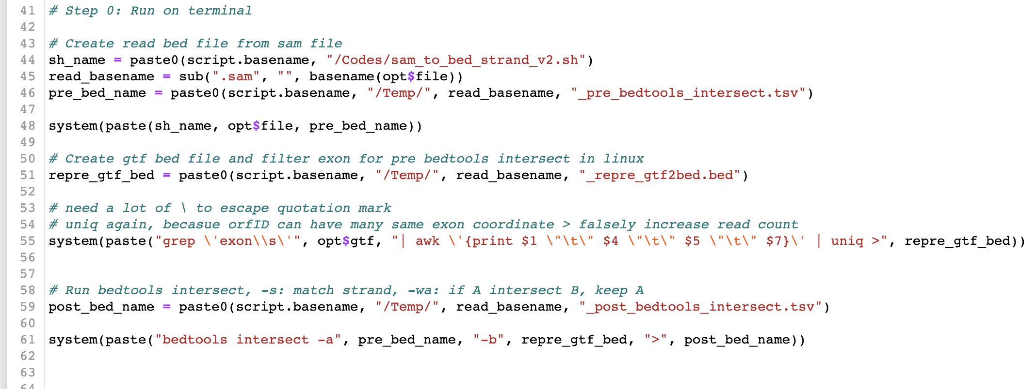
Pre-filter reads on terminal

Slide 4
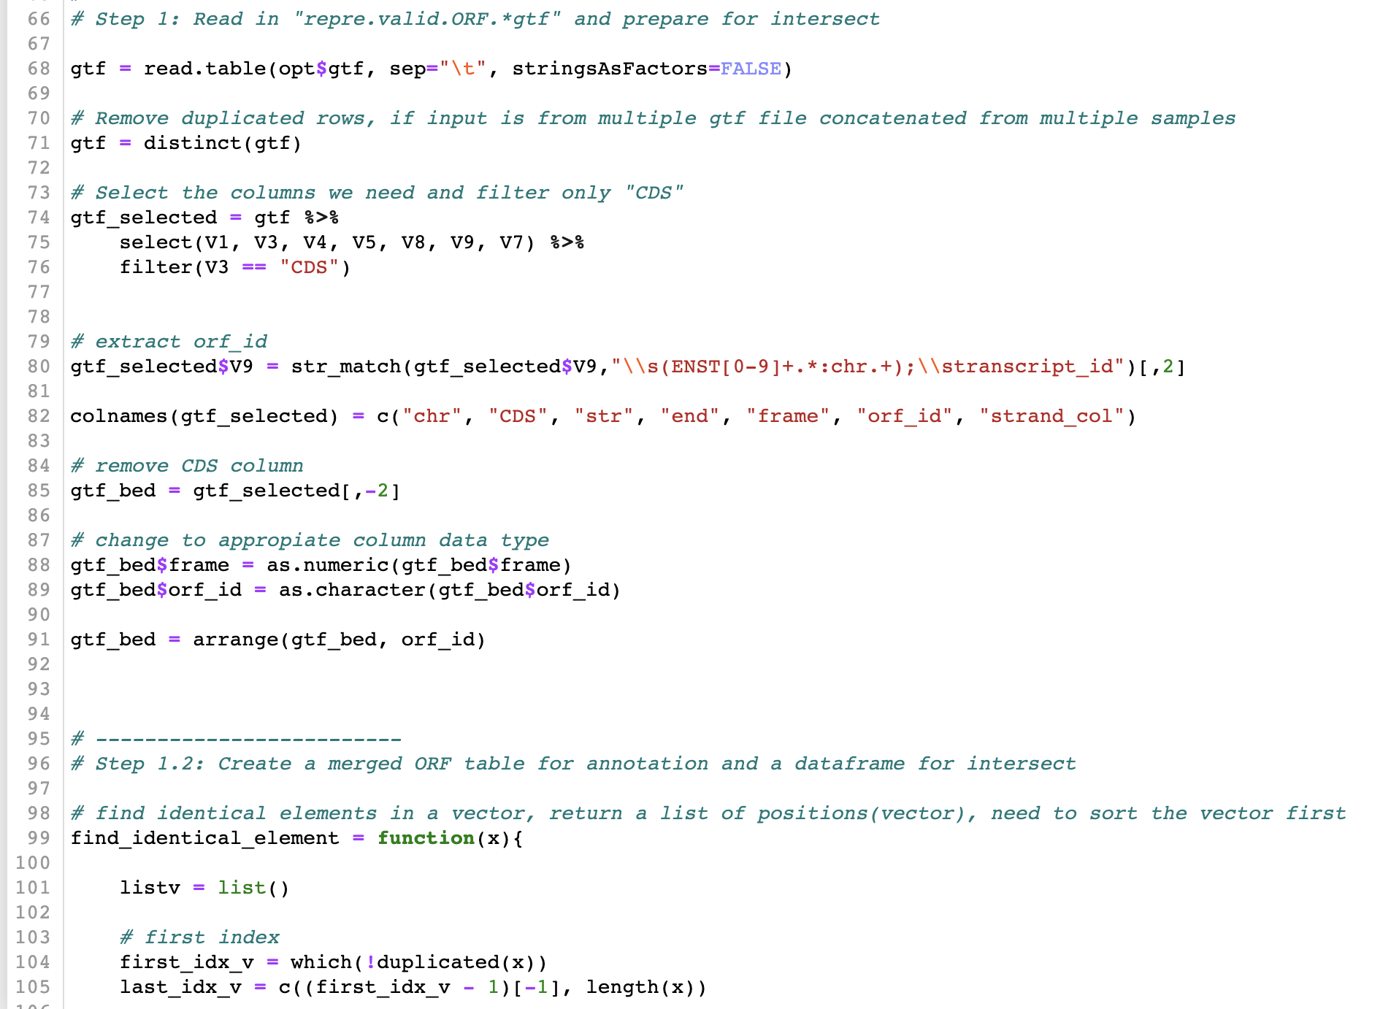
Read in gtf file,
manipulate dataframe

Slide 5
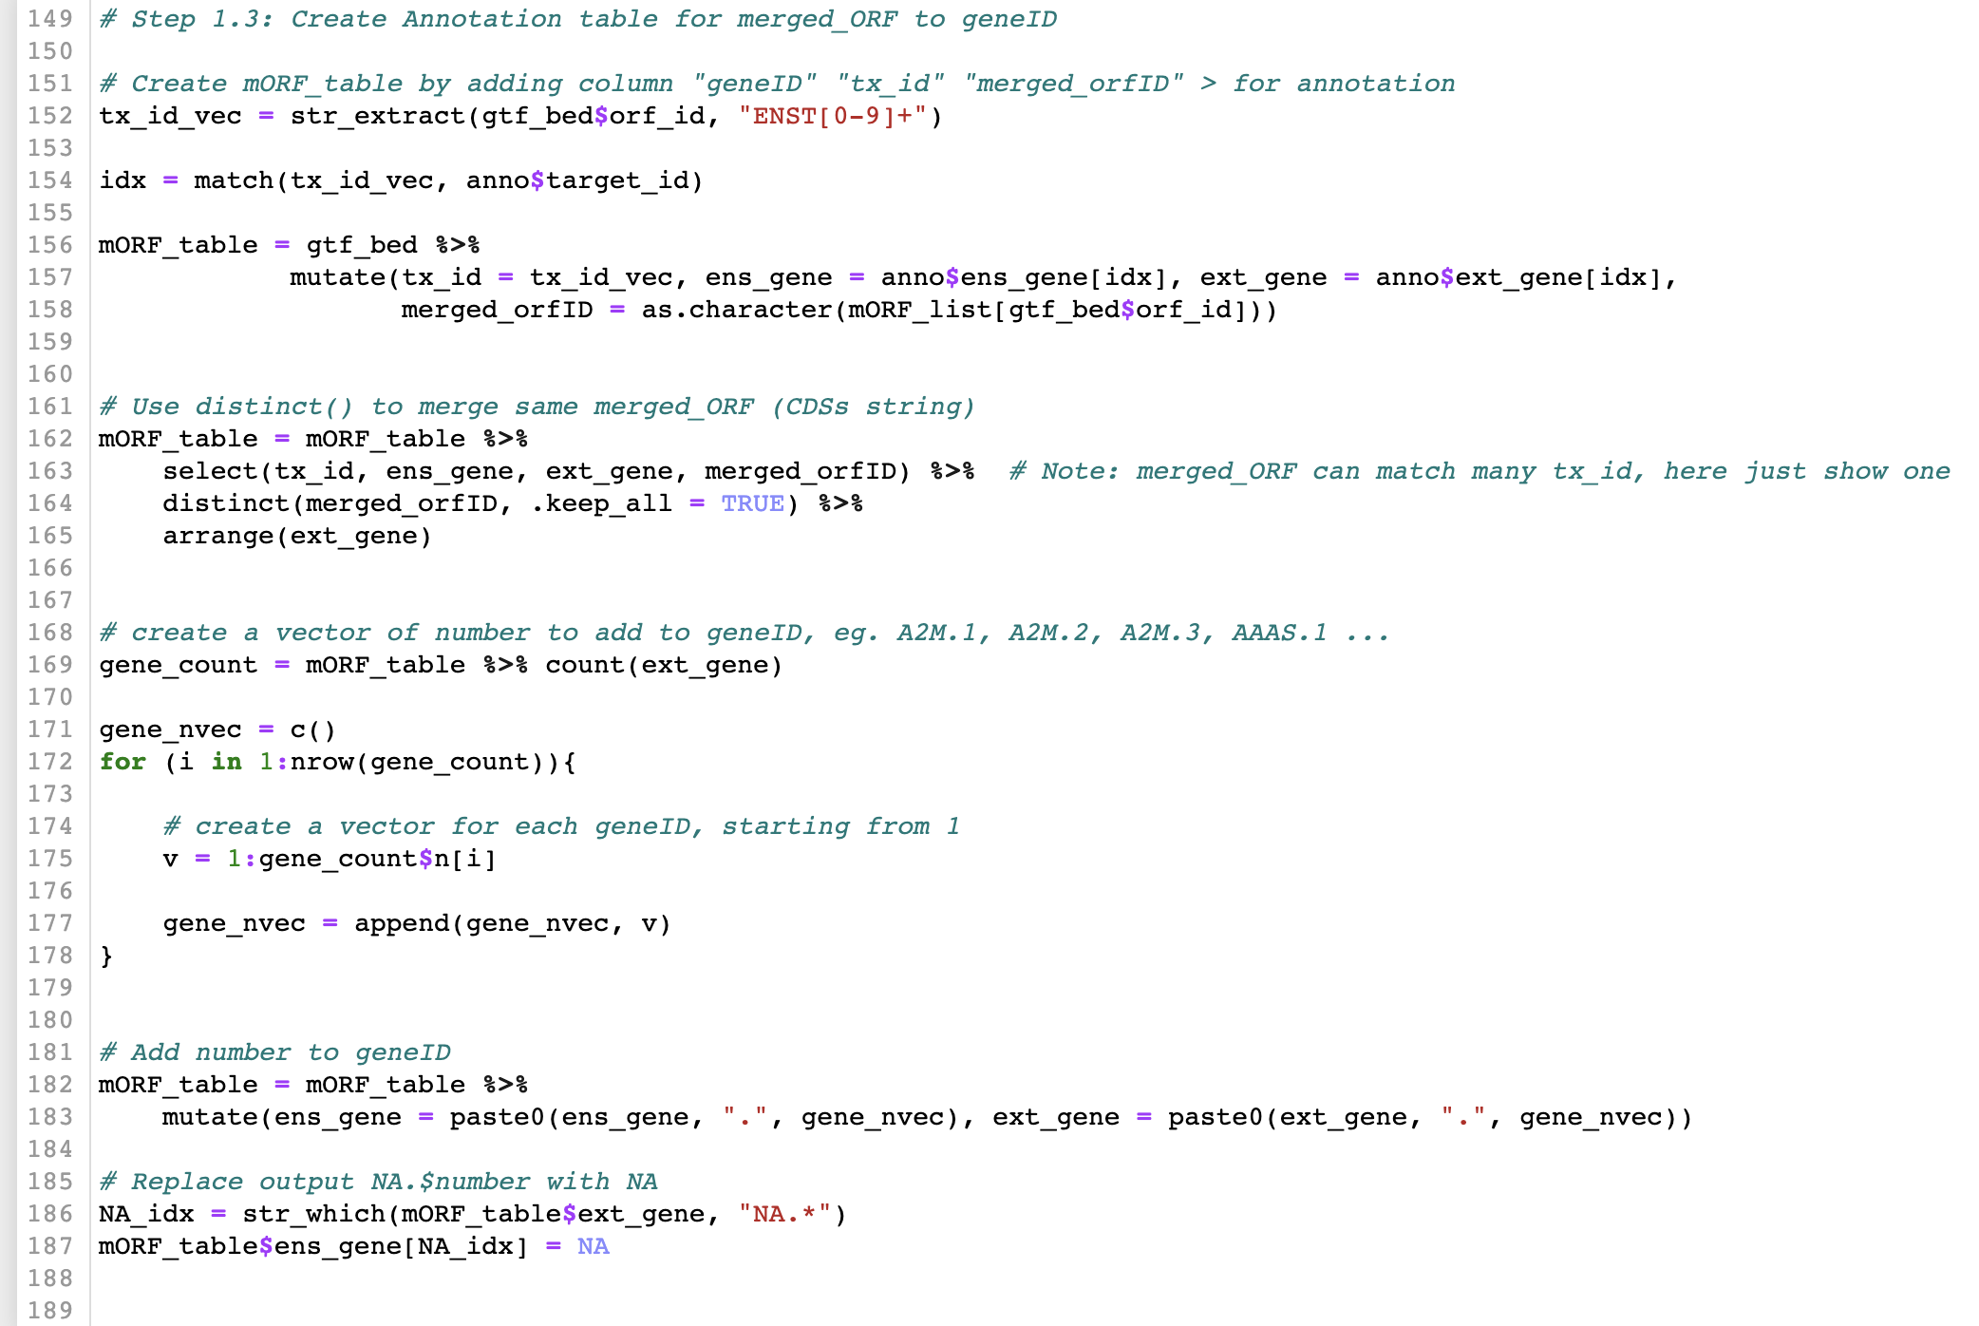
Different ORFs have same set of CDSs > create merge ORF

Slide 6
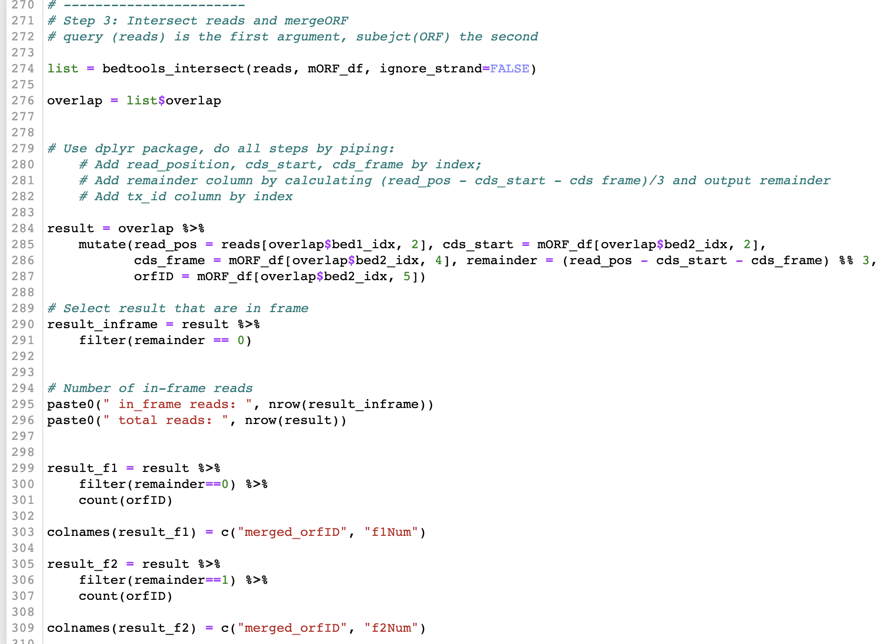
Intersect,
filtering read by frame f1, f2, f3,
count

Slide 7
Run Rscript in one step
# Run steps on server terminal
# Copy package “Ribo_Tony” to your directory:
cp -r /home/tonycheng/Tools/Ribo_Tony PATH/TO/YOUR_DIRECTORY
# Create environment:
conda env create -f tony_r_env.yml
# Activate environment:
conda activate tony_r
Notes:
Rscript Intersect_mergeORF.R -f /home/tonycheng/Data/Fleur_data/sam/GSC2_t0.sam -g /home/tonycheng/Data/Fleur_data/gtf/GSC_total_uniq.repre.valid.ORF.gtf -o /home/tonycheng/Data/Fleur_data/GSC2_t0_mergeORF.tsv
Rscript Intersect_mergeORF.R -f /home/tonycheng/Data/Fleur_data/sam/GSC2_t1.sam -g /home/tonycheng/Data/Fleur_data/gtf/GSC_total_uniq.repre.valid.ORF.gtf -o /home/tonycheng/Data/Fleur_data/GSC2_t1_mergeORF.tsv

Slide 8
Run Rscript in one step
# Input: offset corrected sam file and re.pred.valid.gtf file (can be a concatenated gtf from multiple samples)
# Output: a table with Gene ID and read counts on codon frame 1, 2, 3 position
Rscript PATH/TO/Ribo_Tony/Intersect_mergeORF.R -f ${PATH/TO/*offsetCorrect.sam} -g ${PATH/TO/repre*.gtf} -o ${PATH/TO/OUTPUT_FILENAME.tsv}
Example code:
Rscript /home/tonycheng/Tools/Ribo_Tony/Intersect_mergeORF.R -f /home/tonycheng/Data/Fleur_data/sam/GSC2_t2.sam -g /home/tonycheng/Data/Fleur_data/gtf/GSC_total_uniq.repre.valid.ORF.gtf -o /home/tonycheng/Data/Fleur_data/GSC2_t2_mergeORF.tsv
Notes:
Rscript Intersect_mergeORF.R -f /home/tonycheng/Data/Fleur_data/sam/GSC2_t0.sam -g /home/tonycheng/Data/Fleur_data/gtf/GSC_total_uniq.repre.valid.ORF.gtf -o /home/tonycheng/Data/Fleur_data/GSC2_t0_mergeORF.tsv
Rscript Intersect_mergeORF.R -f /home/tonycheng/Data/Fleur_data/sam/GSC2_t1.sam -g /home/tonycheng/Data/Fleur_data/gtf/GSC_total_uniq.repre.valid.ORF.gtf -o /home/tonycheng/Data/Fleur_data/GSC2_t1_mergeORF.tsv

Slide 9
Prepare a concatenated gtf file
# Concatenate, sort, and remove duplicate row
cat ${gtf file1} ${gtf file2} ${gtf file3} | sort | uniq > ${output_filename}
# Create a directory with all the sample gtf files
mkdir ${folder_name}
Example code:
cat /PATH/TO/DIRECTORY/*.gtf | sort | uniq > GSC_total_uniq.repre.valid.ORF.gtf

Slide 10
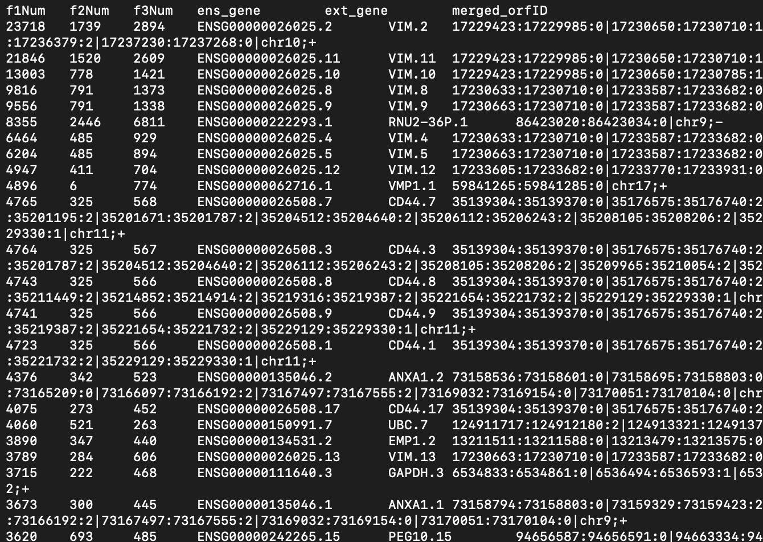
* Read counts on frame 1
Gene ID
Merged ORF: set of CDSs
CDS1 start: end: coding frame | CDS2 start: end: coding frame

Slide 11
Differential Expression Analysis

Slide 12
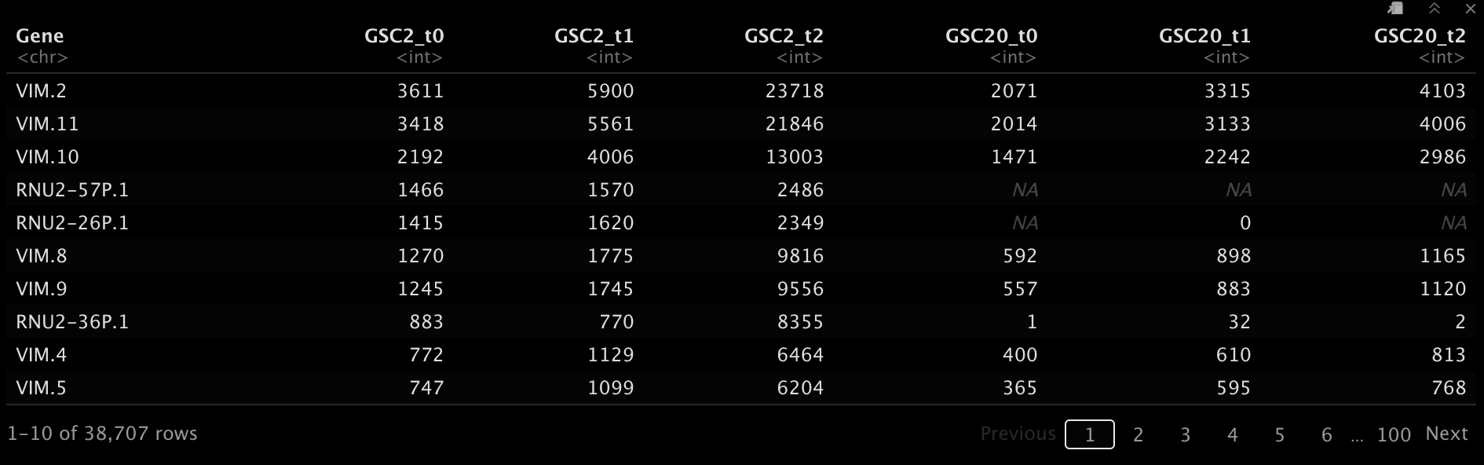
Fluer’s Data
# Two patient sample: GSC2, GSC20
# Three conditions: t=0, t=1, t=2
Notes:
This table show raw read counts, not normalized

Slide 13
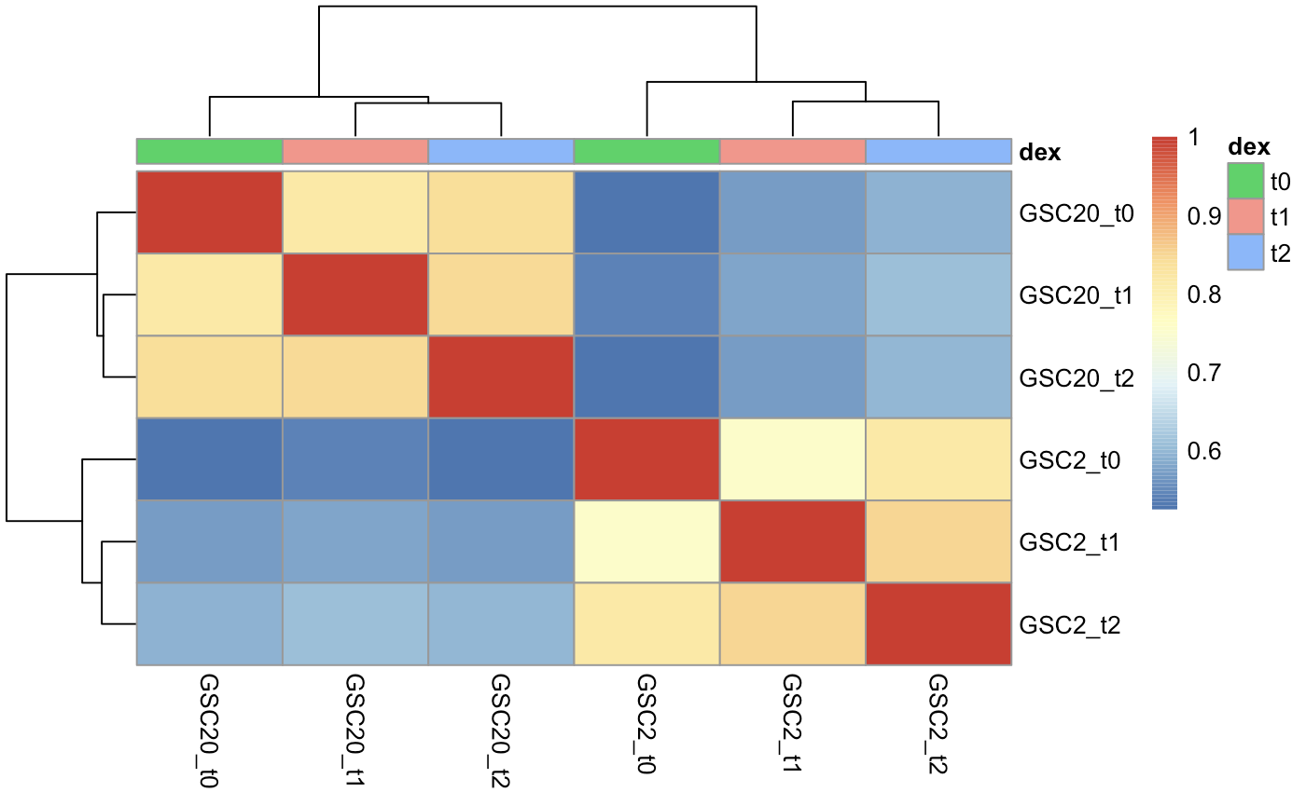
Heatmap
Samples are more correlated between patients rather than conditions
Notes:
Samples are more correlated between patients, rather than condition (t0, t1, t2)

Slide 14
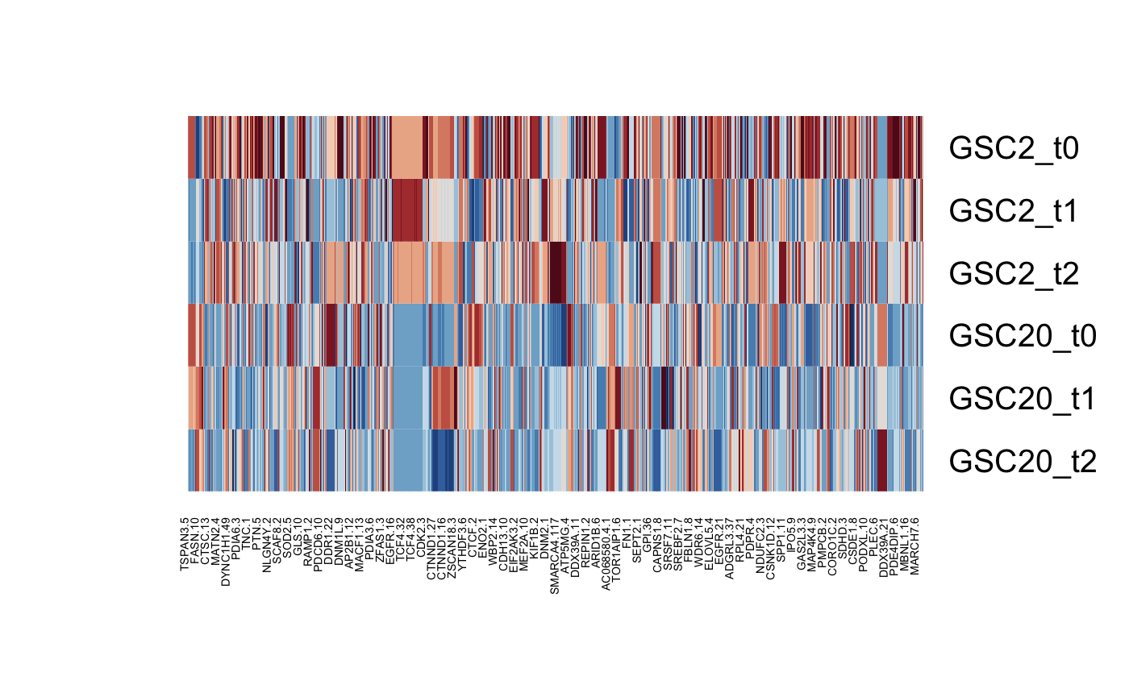
Heatmap

Slide 15
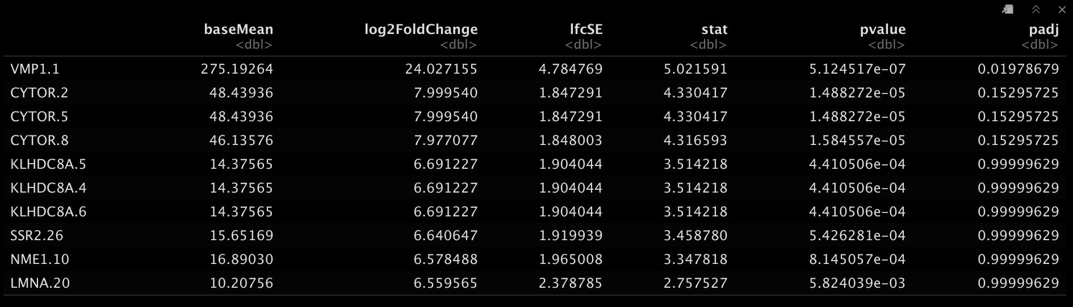
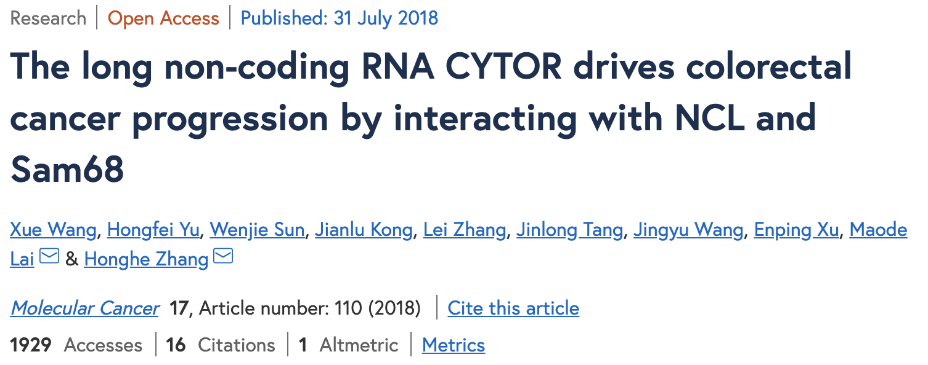
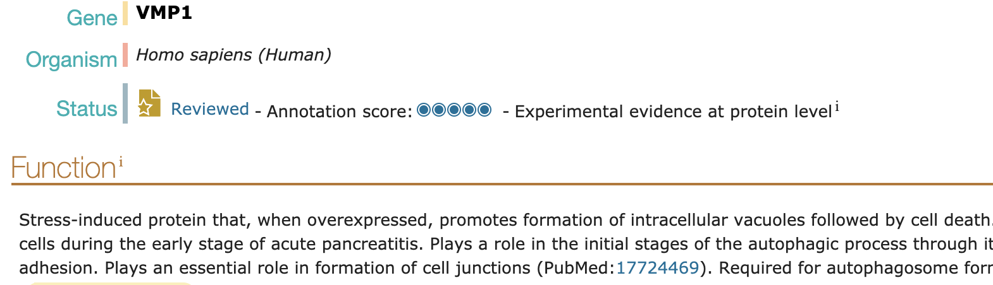
t2 vs t0: order by log2FoldChange

Slide 16
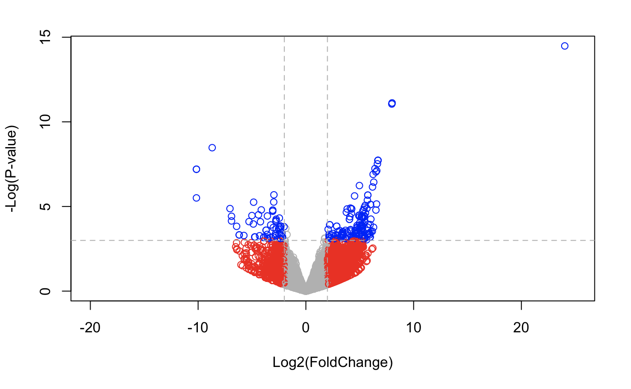
Volcano Plot
VMP1
CYTOR

Slide 17
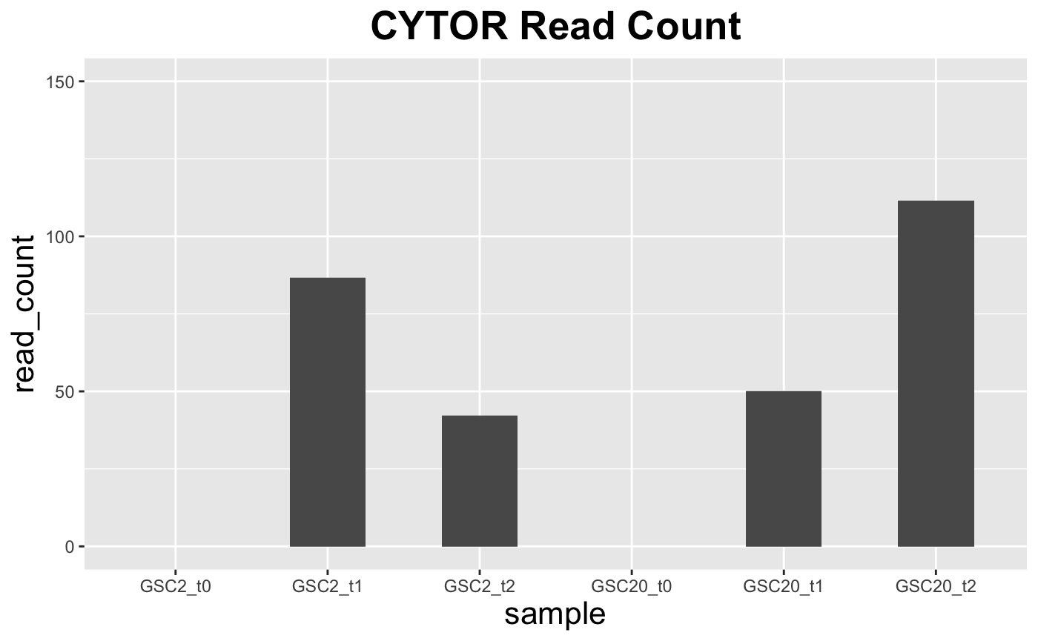
Notes:
Use normalized table to compare

Slide 18
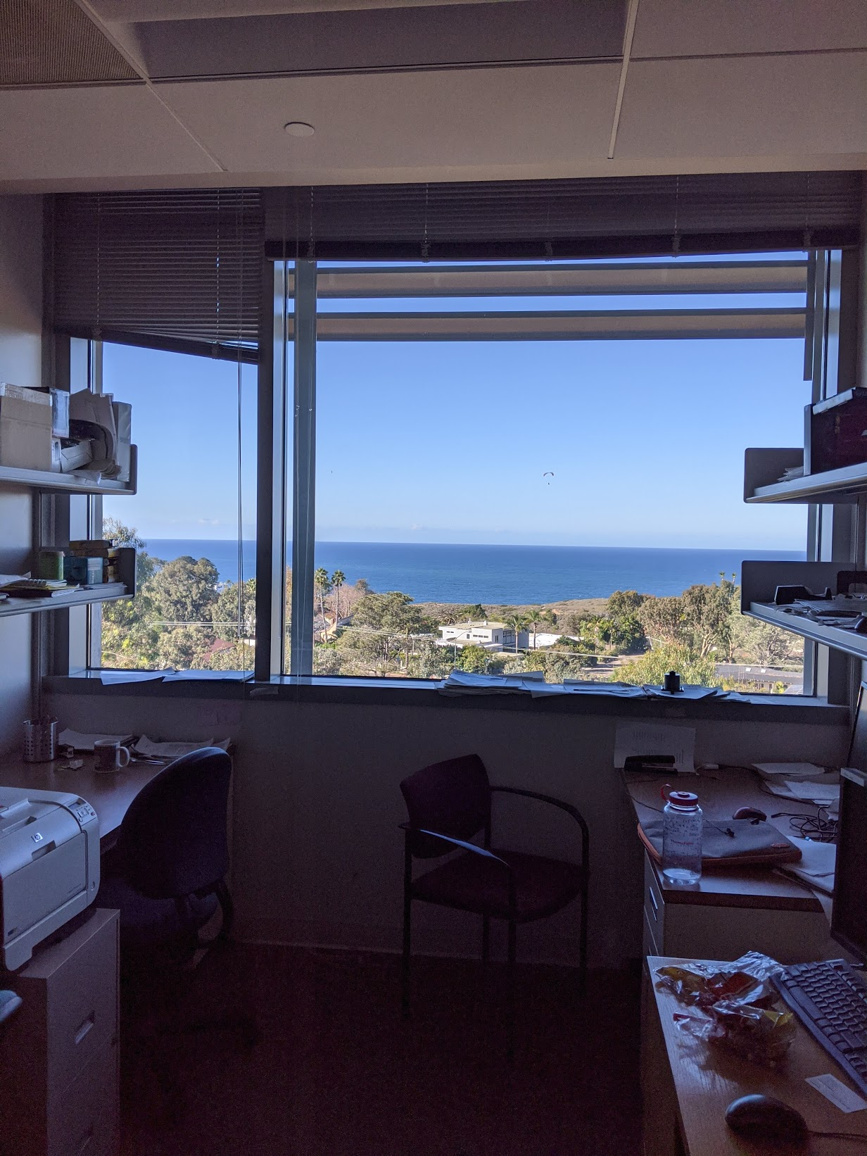
rep("Thank you!", 100)
😀

